Slide 1
Team Members
Fərman Xankişiyev
Project Structer, Github main Cotributor, Project supervisor
Bayram Bayramov
Code implementation, Code Dev. Report fixer
Həsən Məmmədov
Data Additional repo
Mahmu Ramazanov

Slide 2
Central question:
Data information: 3 dataset, linear gaussian, moons, digits_data
Model information: Softmax, NN
Result is that if a model is linear, then it will be able to capture patterns in the dataset that is also linear, or has low rank. Otherwise, to capture non-linearity, there should be sufficient representational capacity of the model.
Why is in the next slide

Slide 3
Why the comparison is fair?
Because, softmax and one layer NN capture the same linear relation. Although the Activation function used was tanh, it adds negligible non-linearity.
Additionally, they were evaluated and trained the same, using same seed, and structure.

Slide 4
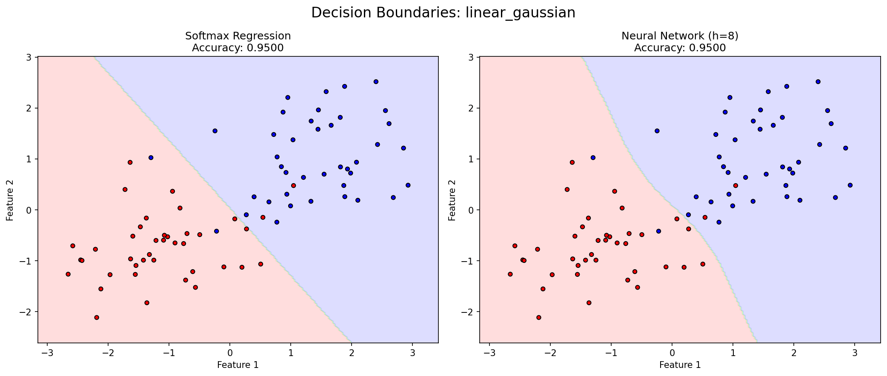
Where linear structure was efficient?
Linear structure of the model was efficient where the data was also linear, for example, gaussian blob. Additionally, digits_data had low rank, which means that it can be represented used few dimensions, which was the reason for this model represented in linear fashion.

Slide 5
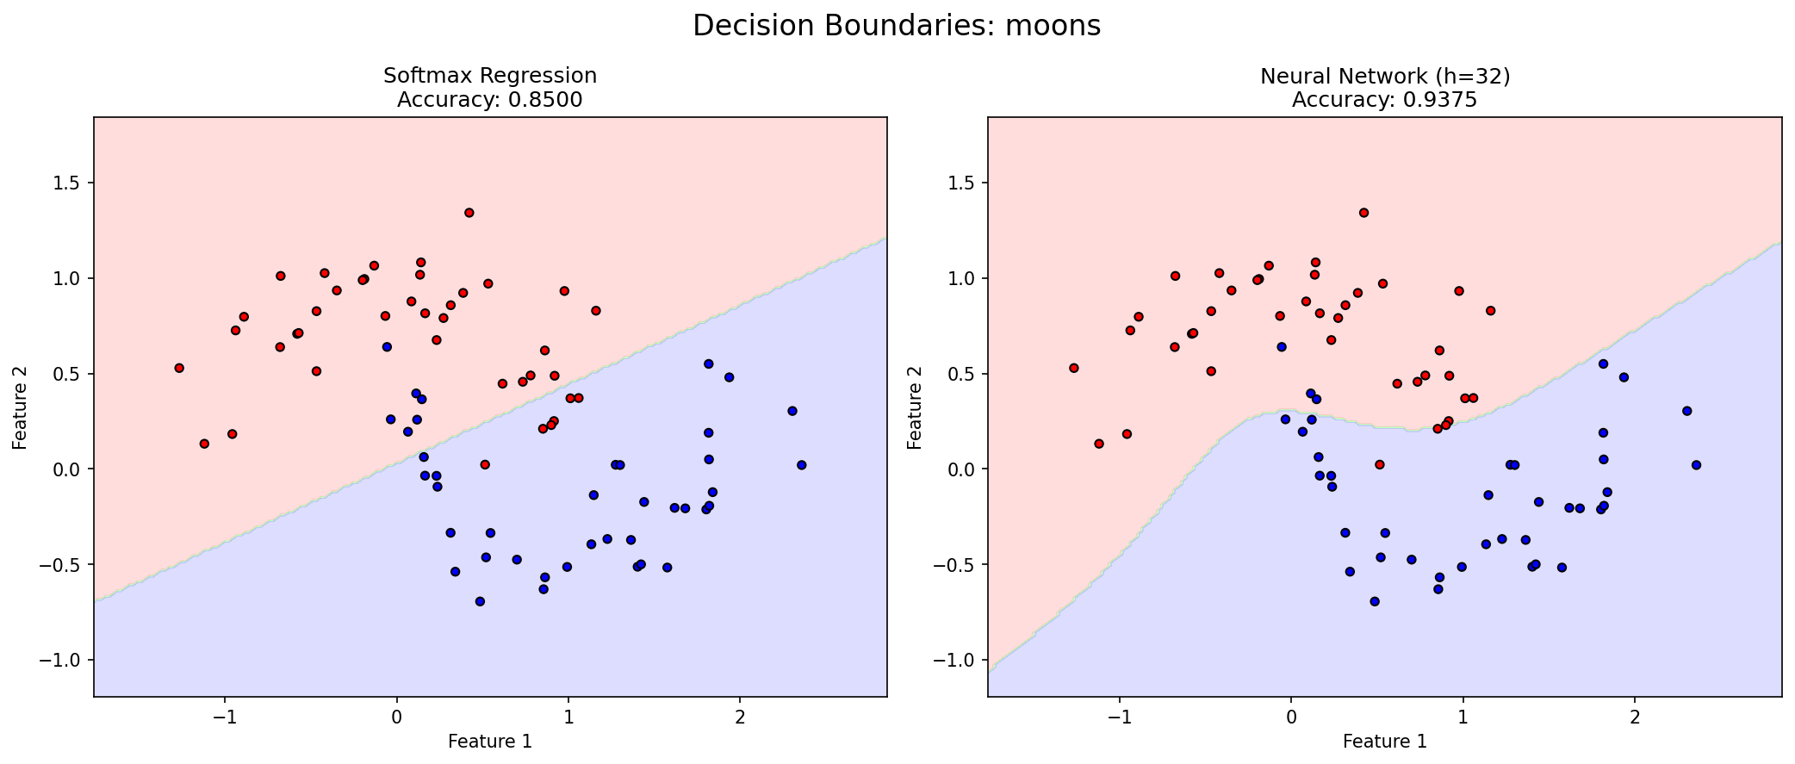
Where non-linearity helped?
Moons dataset integrates non-linearity inside it. It was helpful in that case.

Slide 6
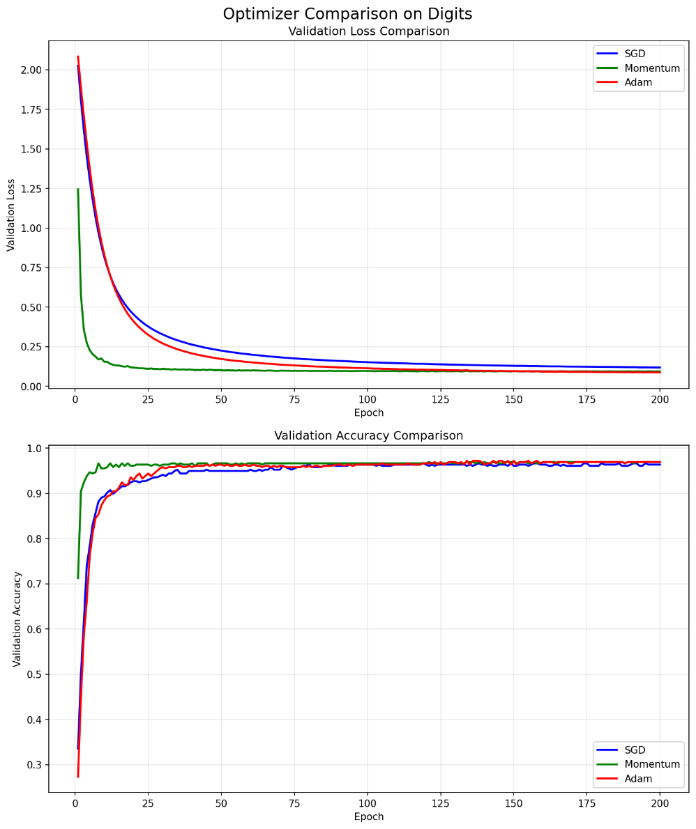
Momentum and Adam converged to solution more efficiently, as opposed to SGD.
dddd

Slide 7
Digits_data contains non-linearity, which NN captures.

Slide 8
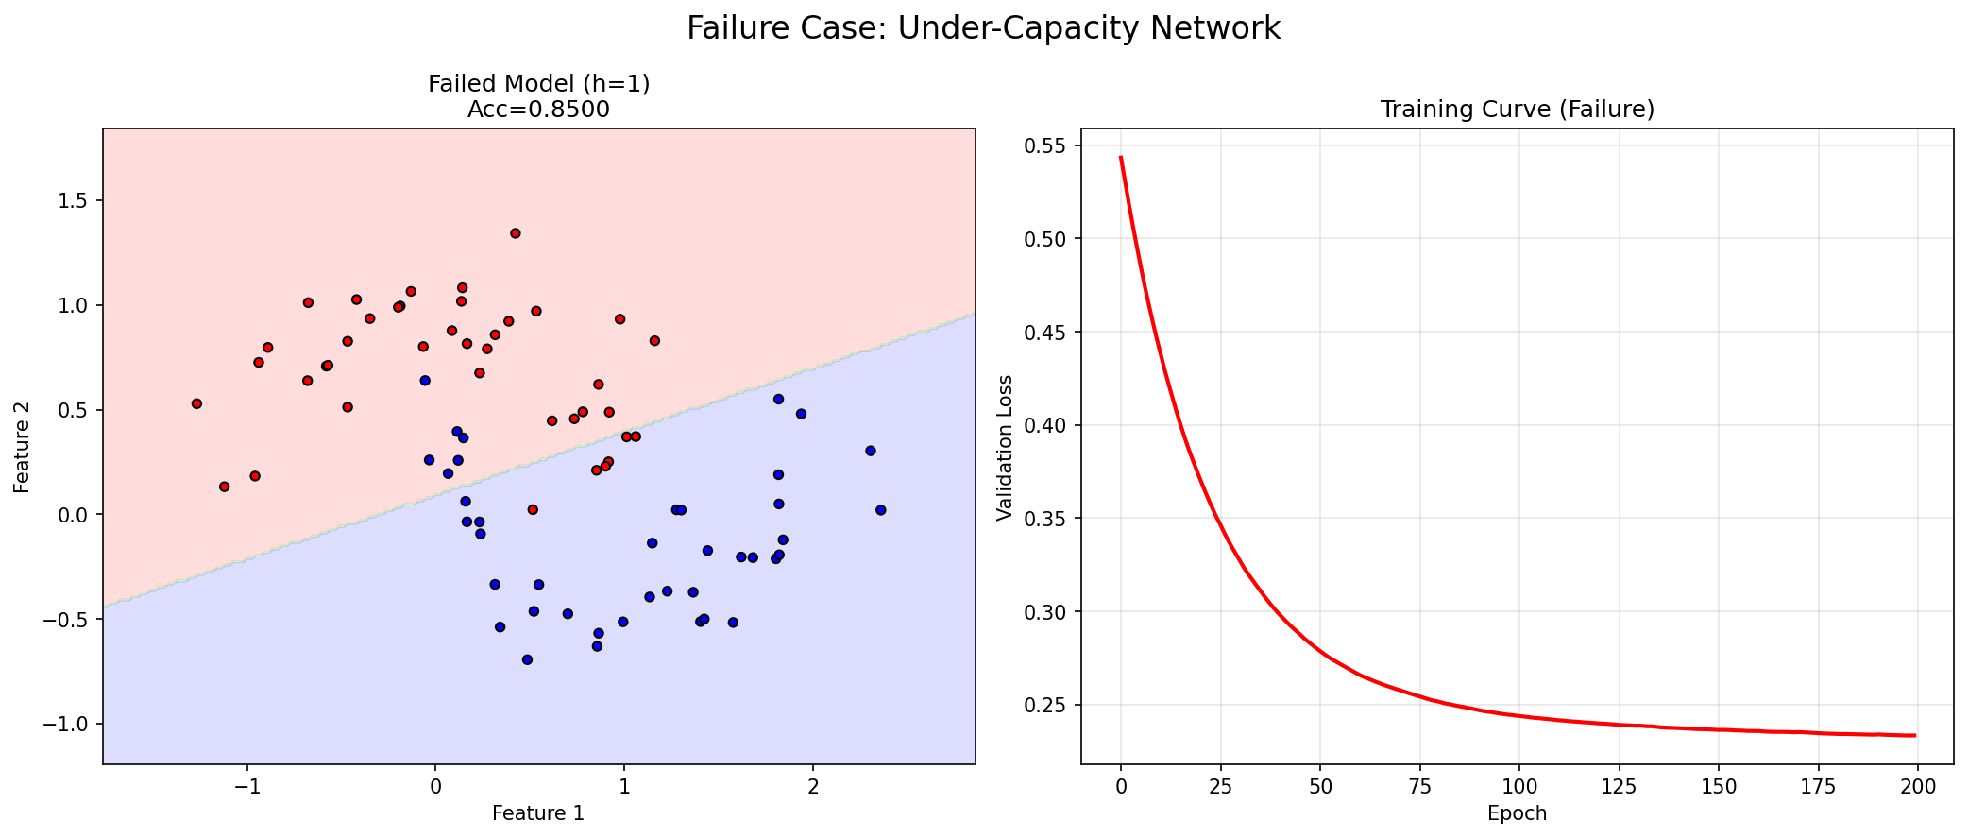
Failure case
H=1 is not enough. Representational capacity matters. In this case, model is only able to capture linear relations, which shows the same results with softmax model.
Although the model converged okay, it lacks the skill of classifying some instances, because NNs have representational capacity. For this case, it was not enough.

Slide 9
Model | Mean Accuracy | 95% CI | Mean Loss | 95% CI
Softmax Regression | 0.9380 | [0.936, 0.940] | 0.2695 | [0.269, 0.270]
Neural Network (h=32) | 0.9533 | [0.950, 0.956] | 0.1657 | [0.161, 0.171]
What repeated seed evaluation adds beyond a single-run?
Single seed evaluation gives just a number, which can be confusing to make decision. Repeated seed evaluation treats the model predictions as distributions, which is useful to know if model’s predictions vary too much.

Slide 10
Limitations
We used 3 datasets, same train/val/test split, no hyperparameter optimization, same layer number evaluation, 2 metrics, same loss to evaluate.

Slide 11
What representational change does the hidden layer provide?
Can wrap decision boundary, can represent complex geometry

Slide 12

When to Use Non-Linear Classifiers: A Comparative Study of Linear vs. One-Hidden-Layer Neural Networks
Reporter:XXX
Date:20XX-XX-XX
Created By AI

Slide 13

Contents
01
Central Question and Hypotheses
02
Ensuring a Fair Comparison
03
03

Slide 14

PART 01
Central Question and Hypotheses

Slide 15

Investigating the Boundary Between Linear and Non-Linear Classification
Core Research Question
Experimental Framework
01
Both models include full forward/backward propagation, three optimization algorithms (SGD, Momentum, Adam), and rigorous gradient verification. The implementation underwent extensive sanity checks, including gradient checks and NaN/Inf detection.
This project investigates when a one-hidden-layer non-linear classifier improves upon a linear decision boundary, and when the added complexity is unnecessary. It implements two models from scratch using NumPy: Softmax Regression (linear) and a One-Hidden-Layer Neural Network (non-linear with tanh activation).
02
03
Systematic Dataset Testing
Guiding Hypotheses
04
Three datasets were used to test the boundary: Linear Gaussian (linearly separable), Moons (non-linear geometry), and Digits (8x8 handwritten digits from scikit-learn).
Three key hypotheses were tested: 1) On linear data, both models perform identically; 2) On non-linear data, the neural network gains a significant advantage; 3) Hidden width increases complexity but may lead to overfitting.

Slide 16
Experimental Results and Key Findings
01
02
Performance on Linear Gaussian
Performance on Moons Dataset
Both models achieved 95% accuracy with identical performance, confirming that linear boundaries are optimal for this geometry.
The neural network achieved 8.75% higher accuracy than Softmax, confirming that curved boundaries require non-linear representations.
03
04
Performance on Digits Benchmark
Capacity Ablation Insights
The neural network achieved 1.5% higher mean accuracy with non-overlapping confidence intervals, showing statistically significant improvement on a real-world task.
On Moons, hidden width h=2 performed like a linear baseline (85% accuracy), h=8 achieved optimal 95% accuracy, and h=32 yielded diminishing returns (93.75% accuracy).

Slide 17

Conclusion on Model Complexity
Justification for Non-Linear Models
Additional model complexity is justified only when the underlying data geometry is non-linear. The neural network adds no benefit for linearly separable tasks but becomes essential when curved decision boundaries are required.

Slide 18
PART 02
Ensuring a Fair Comparison

Slide 19



Controlled Experimental Design
Isolating the Architectural Variable
Identical Training Conditions
Shared Optimization Framework
The comparison isolates one variable: the presence or absence of a hidden layer with non-linear activation. All other factors are held constant to ensure valid conclusions.
Both models were trained under identical conditions: learning rate 0.05 for SGD, L2 regularization (lambda=10^-4), batch size 64, 200 epochs, and best validation loss checkpoint selection.
Both models share identical gradient descent implementation, learning rate schedules, and regularization. The only difference is the model architecture itself, not the optimization procedure.

Slide 20
Rigorous Methodology and Controls
The same train/validation/test splits were applied to all experiments. The validation set was used exclusively for checkpoint selection to prevent data leakage.
Consistent Data Preprocessing
Evaluation used fixed seed for direct comparison and five-seed repeated evaluation for Digits to generate 95% confidence intervals. Statistical significance was confirmed through non-overlapping confidence intervals.
Comprehensive Evaluation Protocol
All gradients were verified using finite differences (epsilon=10^-5, relative error <10^-6). Stable softmax implementation prevented numerical overflow, and systematic NaN/Inf checks were integrated.
Equivalent Engineering Rigor
Hidden width h=32 provided moderate capacity without being excessive. No aggressive learning rate tuning was applied, ensuring the comparison reflects architectural differences, not hyperparameter optimization.
Conservative Neural Network Hyperparameters

Slide 21
Theoretical and Practical Justification
Theoretical Grounding for Comparison
Controlled Confounding Variables
Summary of Fair Comparison
Both models use the same loss function (cross-entropy) and output layer (softmax). The neural network contains Softmax as a special case when hidden width approaches zero, ensuring the comparison measures what it claims to measure.
All confounding variables were controlled: same random seed, learning rate schedule, regularization strength, batch size, shuffle, and early stopping criterion. This ensures internal validity.
The comparison is fair because it isolates the architectural difference while holding all other factors constant. This methodological rigor enables valid conclusions about when non-linear classifiers provide genuine advantages over linear baselines.
01
02
03

Slide 22
Thank you for watching.
Reporter:XXX
Date:20XX-XX-XX

